Slide 1



Cyber Security: Educational Impact
Caden Kelly ● OT Cyber Security Training Modules
ACEP Undergraduate Summer Internship
‹#›
Notes:
Name project (for IT group tell them IK they know but practicing for end of summer) PORTABLE Example of why OT vs IT is different; it is like offic ennetwork
Examples of IT, OT
OT is energy system networks included because OT is industrial system networks, not general
Most of my work applies to both, but the motivation is because of OT

Slide 2
Agenda
August 2026
Problem Statement/Purpose
Research Project Goals
The Bigger Picture
My Project
Challenges and Lessons Learned
Conclusions
Caden Kelly ● Alaska Center for Energy and Power
Notes:
Timing recs:
30 sec
30 sec
1 min
3 min
2 min
2 min

Slide 3
Problem Statement
Rural Alaskan microgrids often lack modern cyber infrastructure and security features
Security:
Aging firewalls/single subnets
Resource constraints
Limited staff
Access to training resources
Cost effective solutions
Caden Kelly ● Alaska Center for Energy and Power
‹#›
Notes:
https://ietresearch.onlinelibrary.wiley.com/doi/10.1049/stg2.70070 https://www.icck.org/article/abs/TEPNS.2026.258528
Security explanation needs to be explained more bc less intuitive than not much resources
https://www.nature.com/articles/s44287-025-00189-z

Slide 4
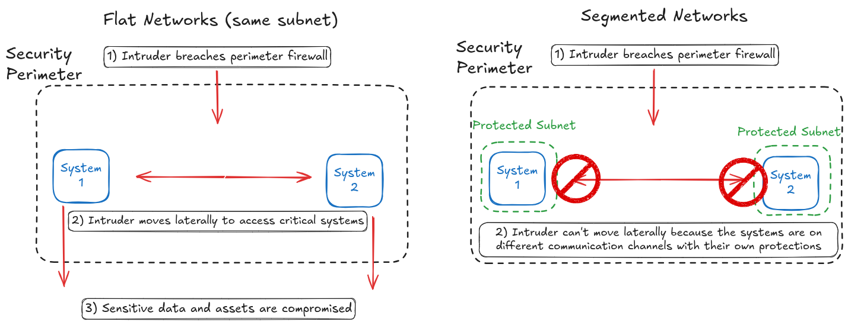
Caden Kelly ● Alaska Center for Energy and Power
Notes:
Segmented is biggest bang for buck to move needle; if asked a question can talk about the behind the meter paper/how applies home. Groupchat nanalogy
Discuss the firewall/network segmentation issues here in a way most can understand
On right side talk about it as a quarantine to limit/isolate systems scope of attack

Slide 5
Problem Statement
Rural Alaskan microgrids often lack modern cyber infrastructure that lacks modern cyber security features
Security:
Aging firewalls/single subnets
Resource constraints
Limited staff
Access to training resources
Cost effective solutions
Caden Kelly ● Alaska Center for Energy and Power
‹#›
Notes:
https://ietresearch.onlinelibrary.wiley.com/doi/10.1049/stg2.70070 https://www.icck.org/article/abs/TEPNS.2026.258528
Security explanation needs to be explained more bc less intuitive than not much resources
https://www.nature.com/articles/s44287-025-00189-z

Slide 6
Research Project Goals
OT Cyber Security Training Modules
Demonstrate a cost-effective segmented network
Low-cost training for beginners
Portability compounds effects
Modular - future potential
Caden Kelly ● Alaska Center for Energy and Power
Notes:
In addition to these issues, we wnat to create a solution that is portable; easy to give access and show this cost effective solution to many

Slide 7
The Bigger Picture
ACEP Goals:
Mission
“To develop and disseminate effective, economic and innovative energy solutions for Alaska and beyond.”
Vision
“Alaska leading the way in innovative, secure and resilient energy systems.”
Caden Kelly ● Alaska Center for Energy and Power
‹#›
Notes:
I am developing the resources to be disseminated; did some very early beta testing. The solution is meant, as just discussed to be cost effective as a new solution for rural Alaskan’s. This can also be deployed to other groups, however
Self explanatory; developing the security systems to help them last

Slide 8
My Project
Orientation
Building Portable Training Ground
Training Module Creation
Testing
Caden Kelly ● Alaska Center for Energy and Power
‹#›
Notes:
I am developing the resources to be disseminated; did some very early beta testing. The solution is meant, as just discussed to be cost effective as a new solution for rural Alaskan’s. This can also be deployed to other groups, however
Self explanatory; developing the security systems to help them last

Slide 9
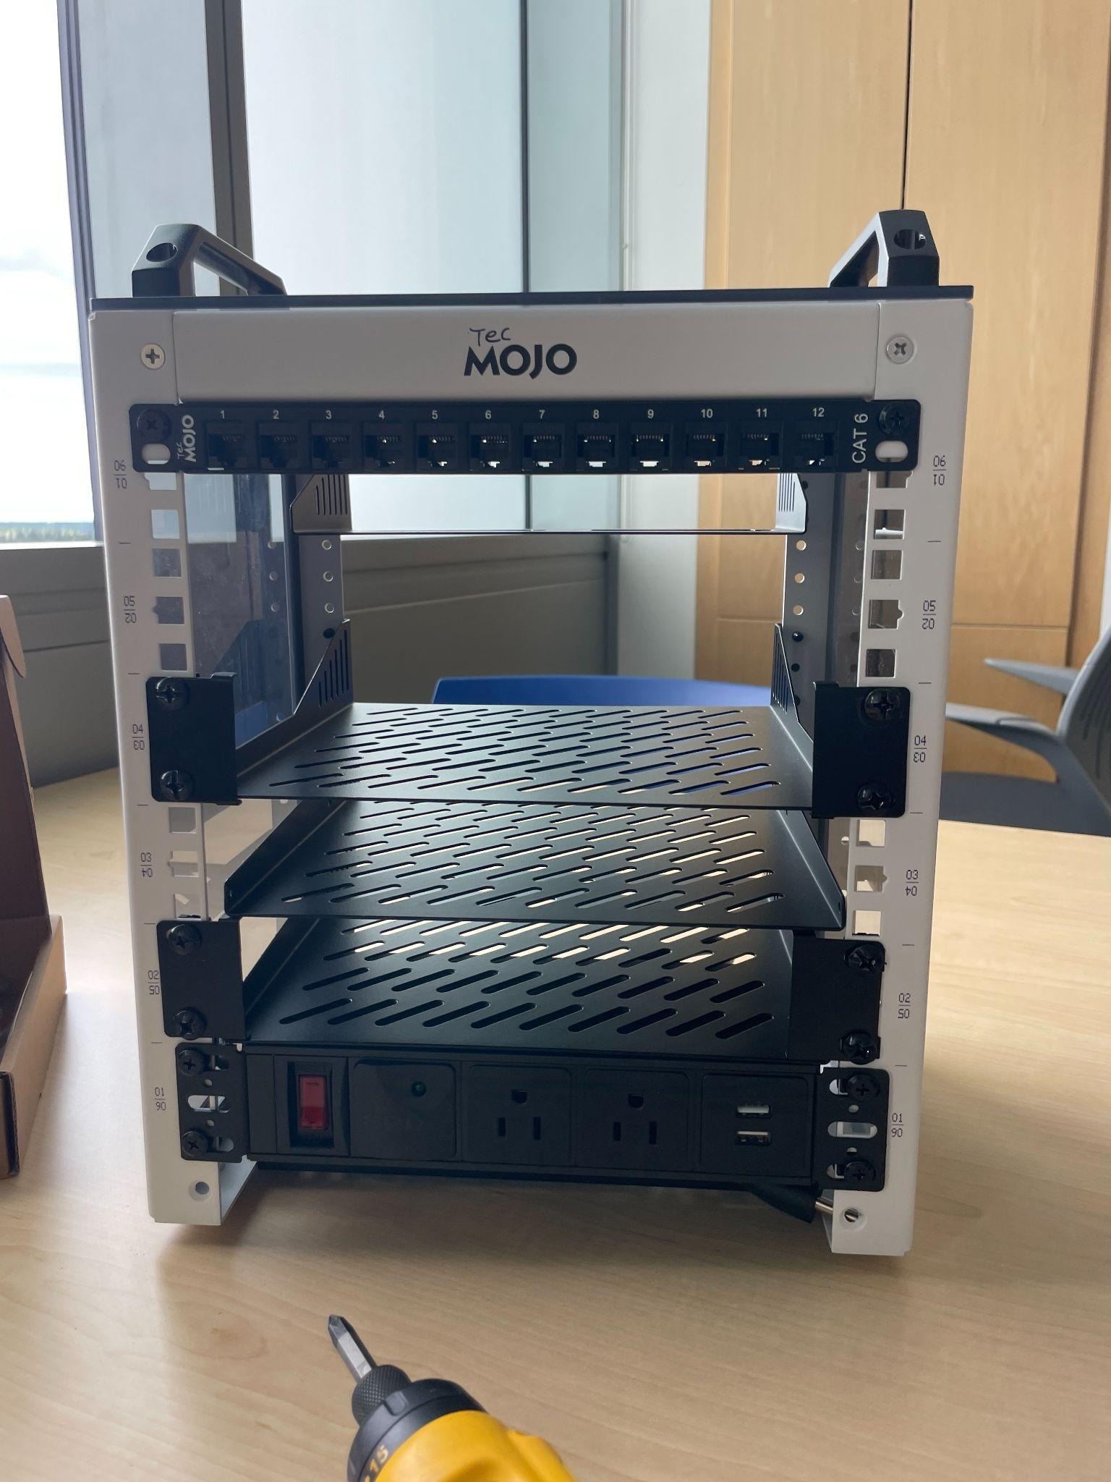
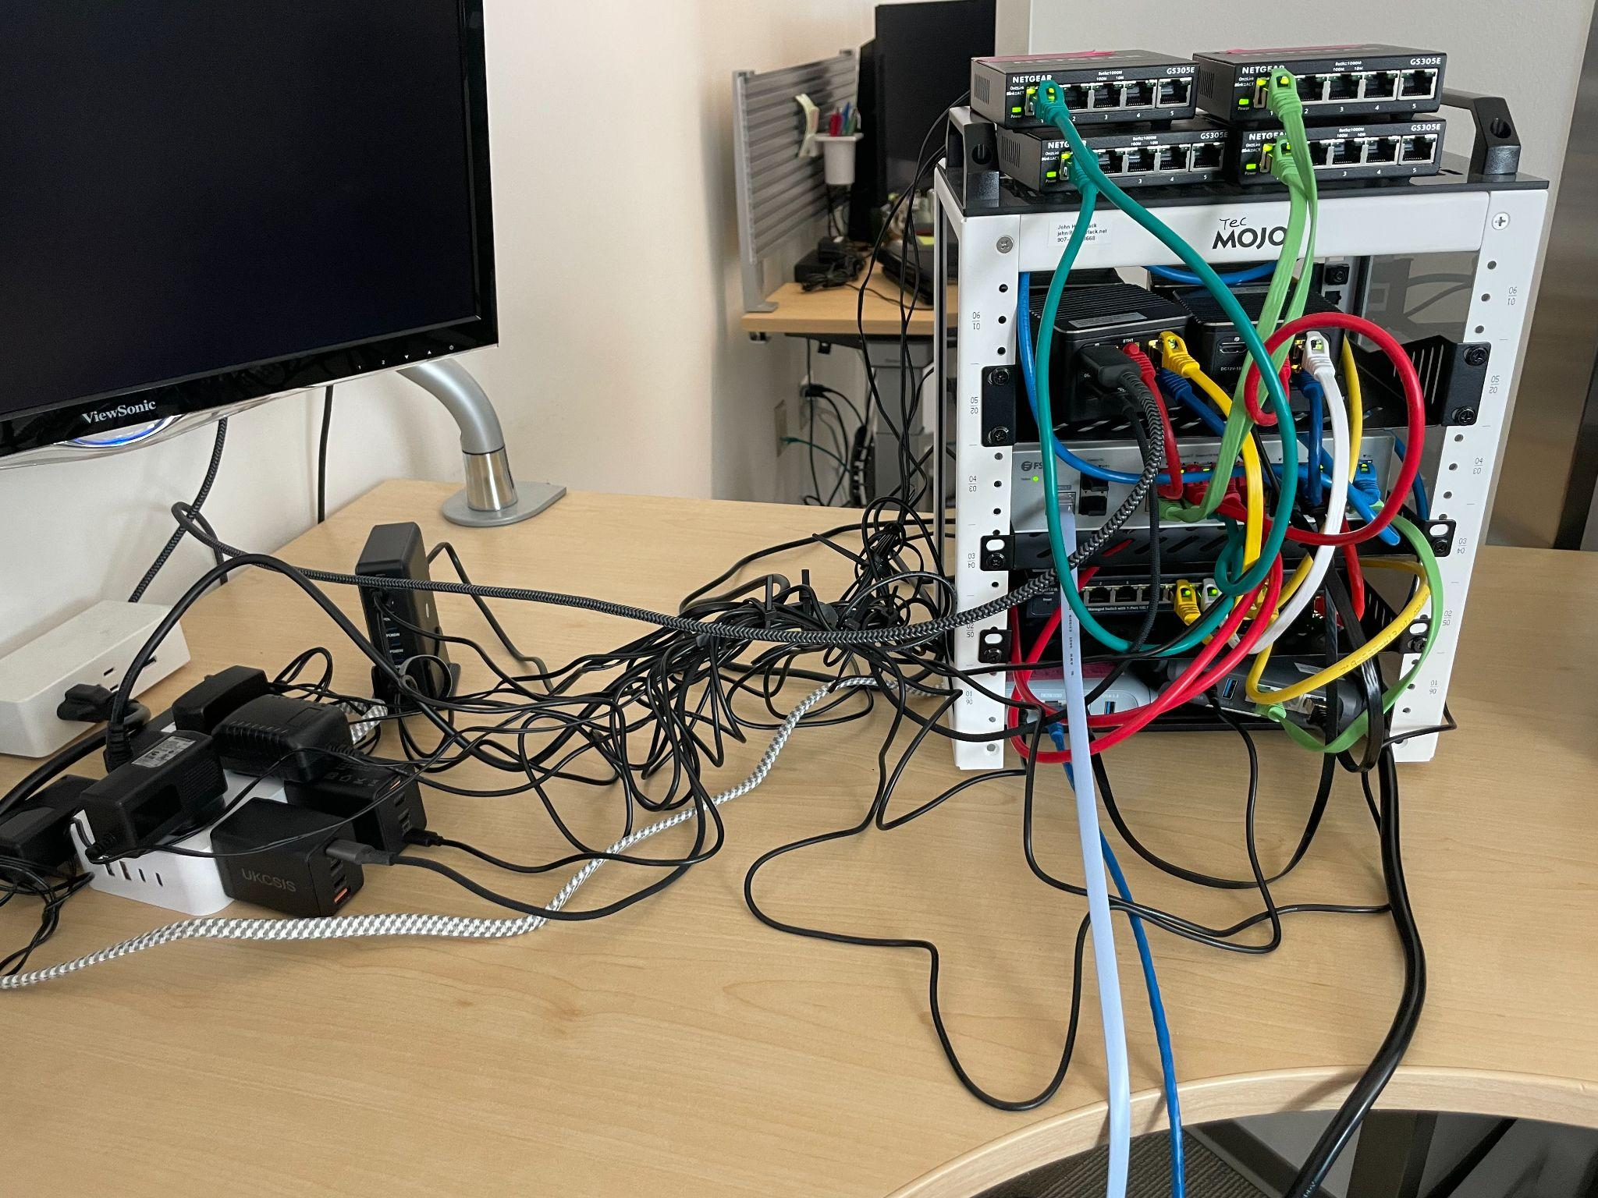
Caden Kelly ● Alaska Center for Energy and Power
Notes:
Discuss how I built the cage, and that this is what it looked like while messy

Slide 10
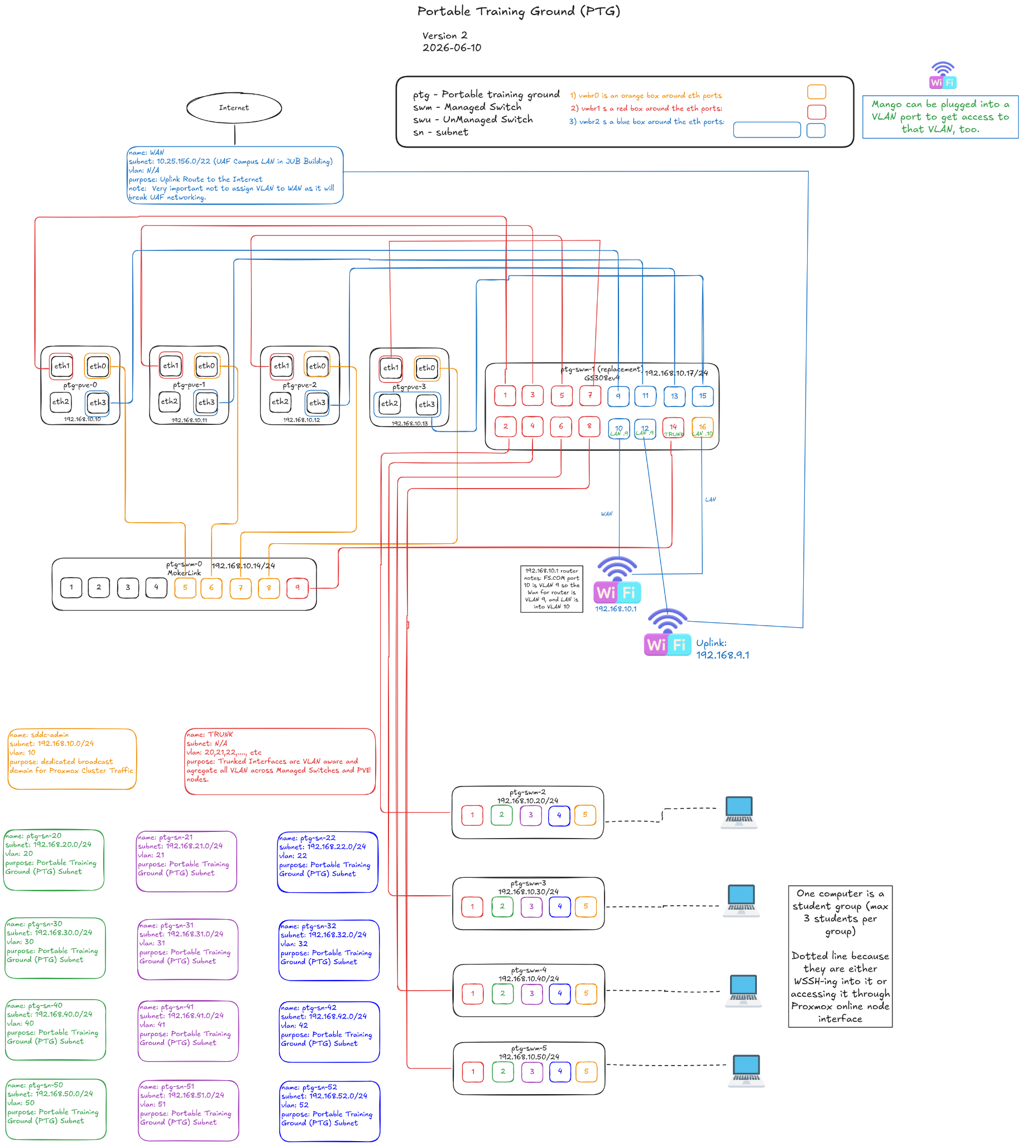
Caden Kelly ● Alaska Center for Energy and Power
Notes:
Two are equivalent.
Four boxes are servers are a software i burned onto a usb then uploaded to the computers. They handled all the virtual computers that students use in the training modules
Color coding not perfect with wires
The diagram’s red is transporting virtual communication channels for the students to interact on; these are segmented networks, that have firewalls as virtual computers in the software system; the firewalls aren’t in the diagram because they only exist in software. But everything talks along the red mostly.
The yellow was an “admin access” Transport of a communication channel that lets us access anything, so if something broke, we could go in and try to fix it
Blue is connection to wider internet “WAN”
Down below are student stations. You can see these in the virtual environment, but each student has their own communication channel they could log into through an online web service I downloaded into the computers
This was used mainly for module 2, when I Was teaching them to configure segmented networks and firewalls
Two routers: One is to connect to the wider university wifi so you can use the internet on it. Then it uses its own subnet to act as a barrier between the wifi and the rest of the network, because we don’t want to have our local network traffic interfere with the internet or university can auto-block us if registers our VLANs
Other router is giving IP addresses to everything. This is the admin channel

Slide 11
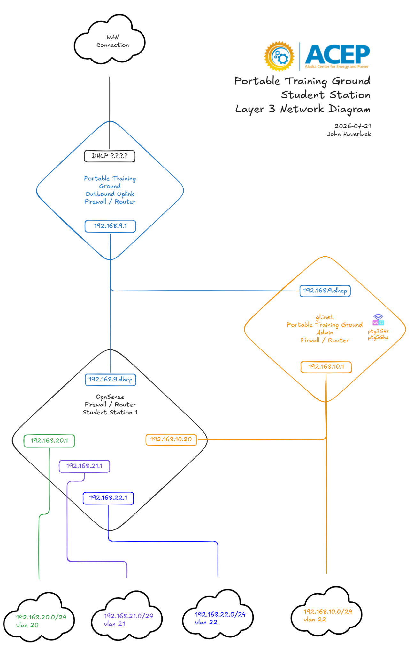
Caden Kelly ● Alaska Center for Energy and Power
Notes:
Mention how the example firewall station is one per station, and we had 4 of these virtually
Segmented networks to really improve done on training grounds

Slide 12
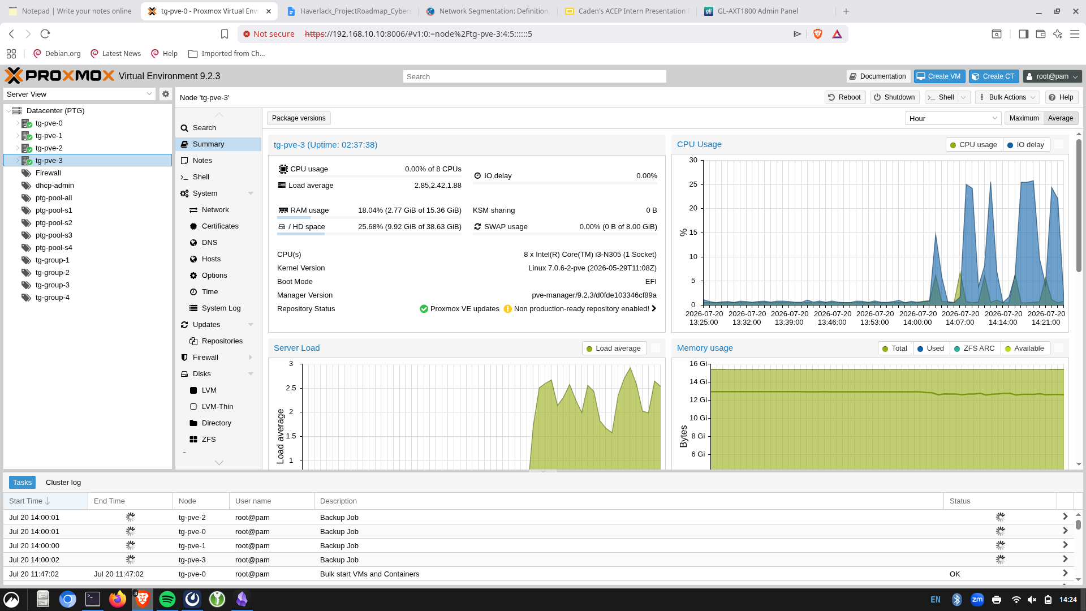
Caden Kelly ● Alaska Center for Energy and Power
Notes:
Explain that the 4 servers were the boxes, and let me host memory spread out across them of student devices. I separated the student VMs roughly equally so they had similar performance.

Slide 13
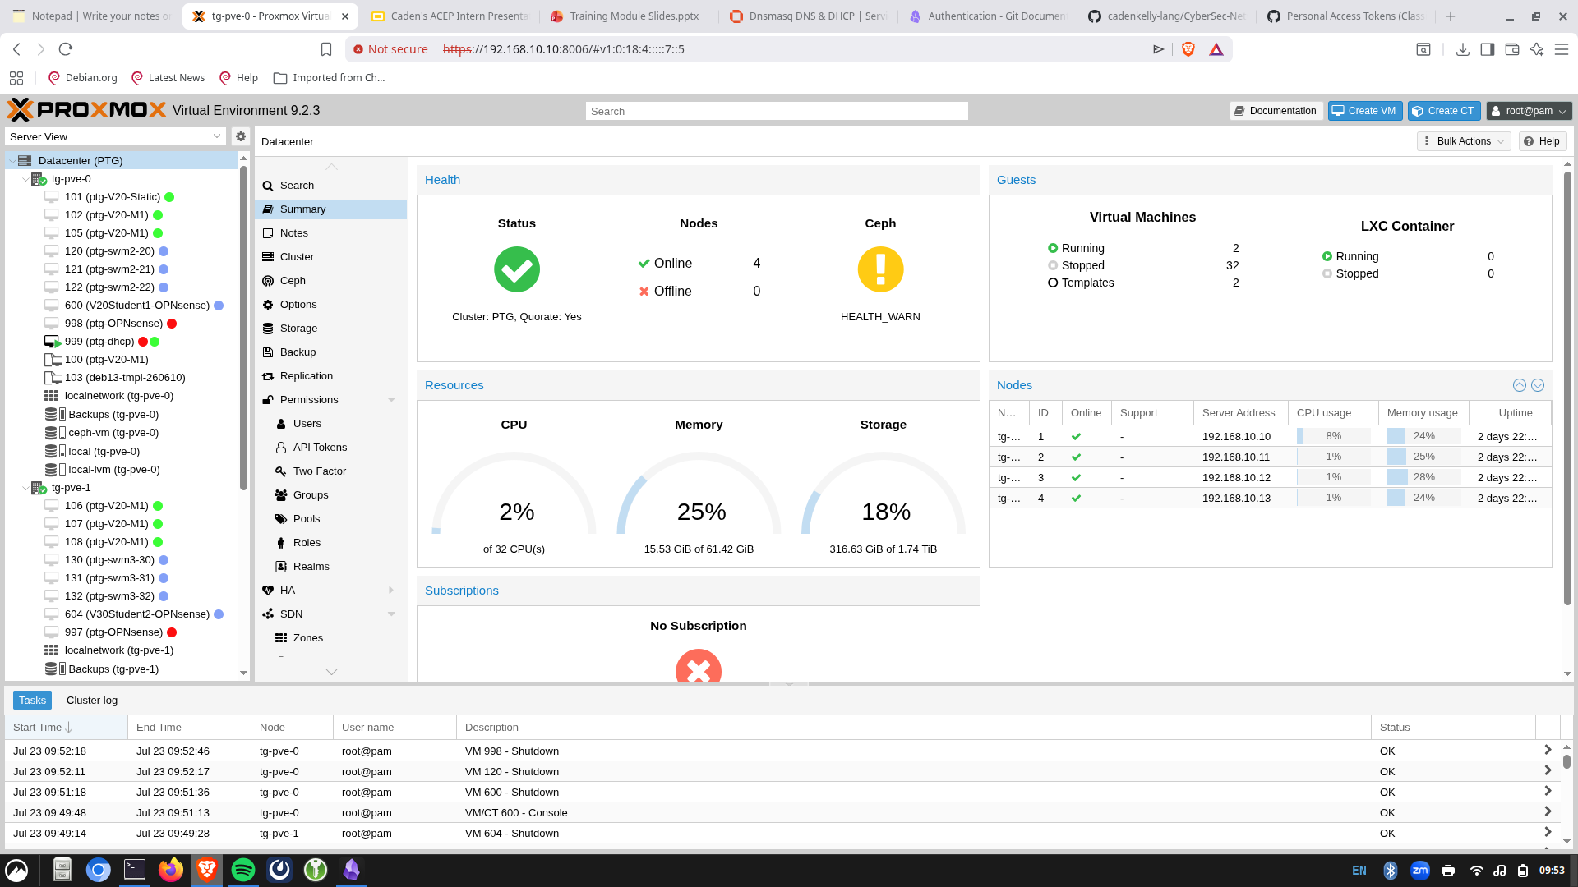
Caden Kelly ● Alaska Center for Energy and Power
Notes:
Overall data summary and memory usage on left
Then explain my tags on the VMs for modules 1 and 2 and the segmented networkin goals of all on same subnet vs not
Explain my firewalls, then their firewalls (for networking group; the firewalls not fully done yet; will change picture before EOS pres)

Slide 14
My Project
Orientation
Building Portable Training Ground
Training Module Creation
Testing
Caden Kelly ● Alaska Center for Energy and Power
‹#›
Notes:
I am developing the resources to be disseminated; did some very early beta testing. The solution is meant, as just discussed to be cost effective as a new solution for rural Alaskan’s. This can also be deployed to other groups, however
Self explanatory; developing the security systems to help them last

Slide 15
Module 1: IPv4 Network Basics
M1: ​
1:30pm – 1:50pm - Your terminal, Linux ​
1:50pm – 2:20pm - Binary, IPv4, (ping, broadcast, subnets and their mask, etc.)​
2:20pm – 2:50pm - DHCP/MAC/DNS​
2:50pm – 3:00pm - 10 minute break​
3:00pm – 3:30pm - NTP, LAN, Network Segmentation ​
End of Module 1​
Caden Kelly ● Alaska Center for Energy and Power
Notes:
This slide is for teaching them to walk before running. Activities for each section, but its a lot of learning
I made a bunch of slides for a training module; all sections, activities, challenges, interactions etc are using the interface of the virtual computers, so for example, if i wanted them to see a communication difference on the same vs different subnets, I’d have them send each other a ping on the same subnet, see that it works, then that it doesn’t when on a segmented network. There were many other activities, but that functions as a decent example

Slide 16
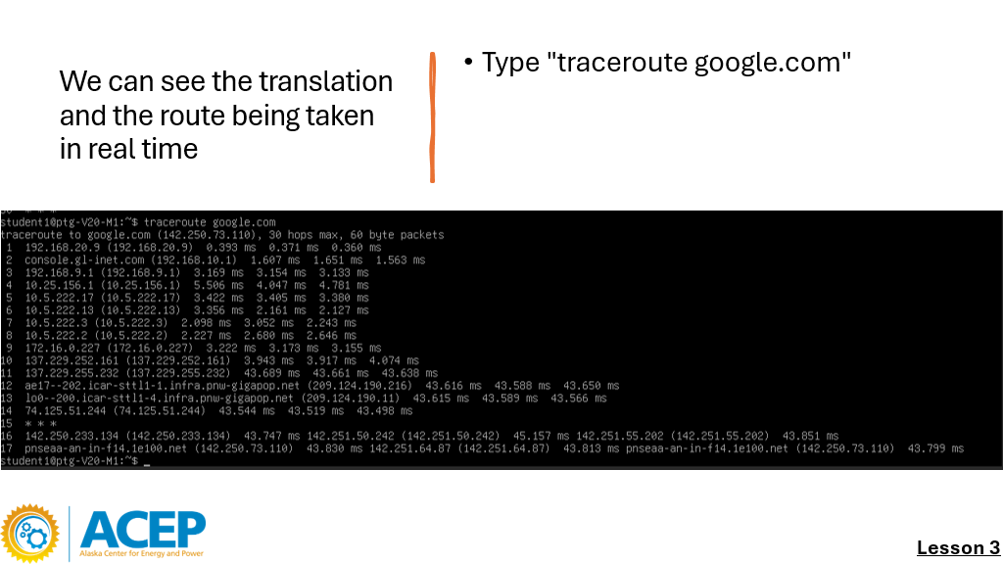
Aside from the pinging activity for network segmentation, there were many others…
Caden Kelly ● Alaska Center for Energy and Power
Notes:
Here, they are using their own computers to get a visual route of the translation your computer does when you type in a host name, then it gets a number address back to you that lets you use a website Juztapose traceroute with layer 3 diagram

Slide 17
Module 2: Firewalls
M2:
3:30pm – 4:10pm - What is a Firewall? Diagram Current Network, Get Into OPNsense WUI​
4:10pm – 4:20pm - 10 minute break​
4:20pm – 5:20pm - Configure VM DHCP, DNS, and NTP, Testing​
5:20pm – 6:20pm - Firewall Rules, Configuration, Testing​
6:20pm – 6:30pm - Feedback Form, END
Caden Kelly ● Alaska Center for Energy and Power
Notes:
End goal: Segmented network building and firewalls
Bringing this capability to other Alaskans
This module they configure their own firewall with services we just learned about, and their firewall rules with what traffic to limit etc. to understand how to make strong firewall rules
I made a bunch of slides for a training module; all sections, activities, challenges, interactions etc are using the interface of the virtual computers, so for example, if i wanted them to see a communication difference on the same vs different subnets, I’d have them send each other a ping on the same subnet, see that it works, then that it doesn’t when on a segmented network. There were many other activities, but that functions as a decent example
Mention feedback form

Slide 18
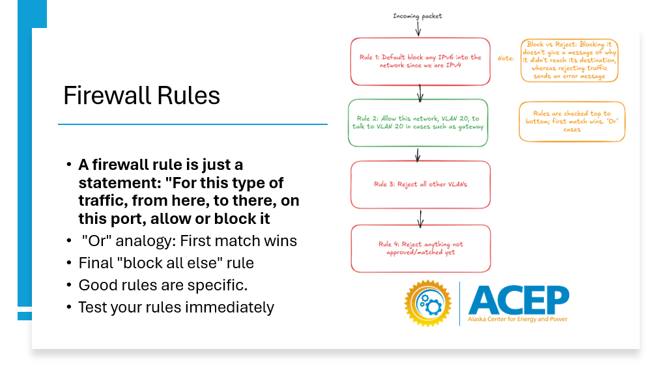
Caden Kelly ● Alaska Center for Energy and Power
Notes:
Made many diagrams for the modules, and had them configure their own baseline of rules before changing it

Slide 19
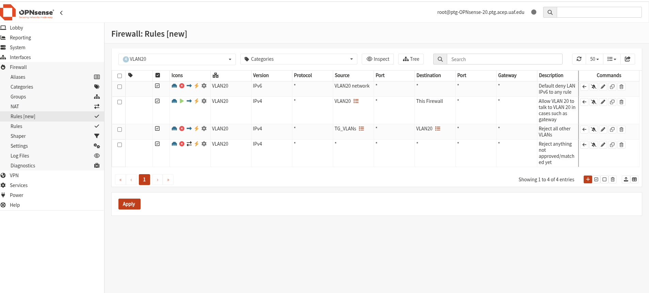
Caden Kelly ● Alaska Center for Energy and Power
Notes:
Which looks like this in the software we used for firewalls

Slide 20
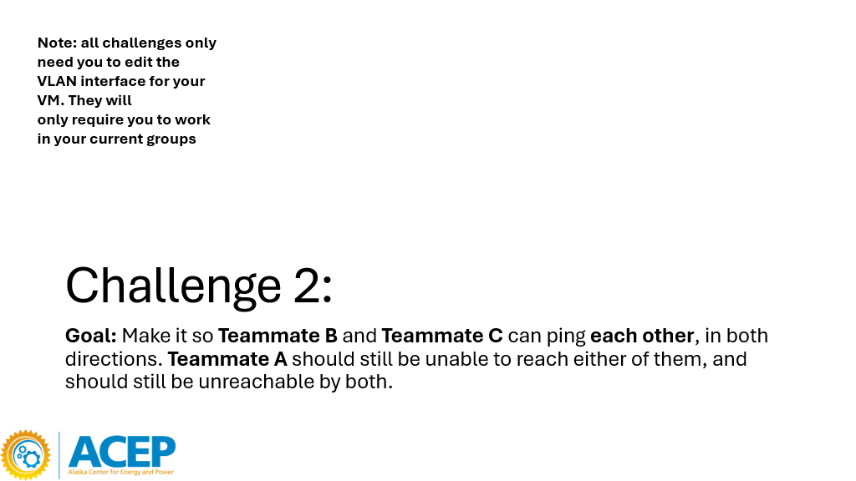
Caden Kelly ● Alaska Center for Energy and Power
Notes:
As well as challenges for them to change their own rules to accomplish different goals
May need to update slide as this is for a config where everyone is on their own firewall

Slide 21
Challenges
Challenges:
Hardware + University limitations leading to unusual setups
Learning EVERY switch interface
Caden Kelly ● Alaska Center for Energy and Power
‹#›

Slide 22
Caden Kelly ● Alaska Center for Energy and Power
Notes:
Two are equivalent.
Four boxes are servers are a software i burned onto a usb then uploaded to the computers. They handled all the virtual computers that students use in the training modules
Color coding not perfect with wires
The diagram’s red is transporting virtual communication channels for the students to interact on; these are segmented networks, that have firewalls as virtual computers in the software system; the firewalls aren’t in the diagram because they only exist in software. But everything talks along the red mostly.
The yellow was an “admin access” Transport of a communication channel that lets us access anything, so if something broke, we could go in and try to fix it
Blue is connection to wider internet “WAN”
Down below are student stations. You can see these in the virtual environment, but each student has their own communication channel they could log into through an online web service I downloaded into the computers
This was used mainly for module 2, when I Was teaching them to configure segmented networks and firewalls
Two routers: One is to connect to the wider university wifi so you can use the internet on it. Then it uses its own subnet to act as a barrier between the wifi and the rest of the network, because we don’t want to have our local network traffic interfere with the internet or university can auto-block us if registers our VLANs
Other router is giving IP addresses to everything. This is the admin channel
Learned sometimes what works rn is better than what is perfect/ideal. Also, principle of least access with trying not to tick off uni wifi firewall with my own network, and also working below ideal conditions and succeeding, persevering

Slide 23
Challenges
Challenges:
Hardware + University limitations leading to unusual setups
Learning EVERY switch/router interface
Caden Kelly ● Alaska Center for Energy and Power
‹#›

Slide 24
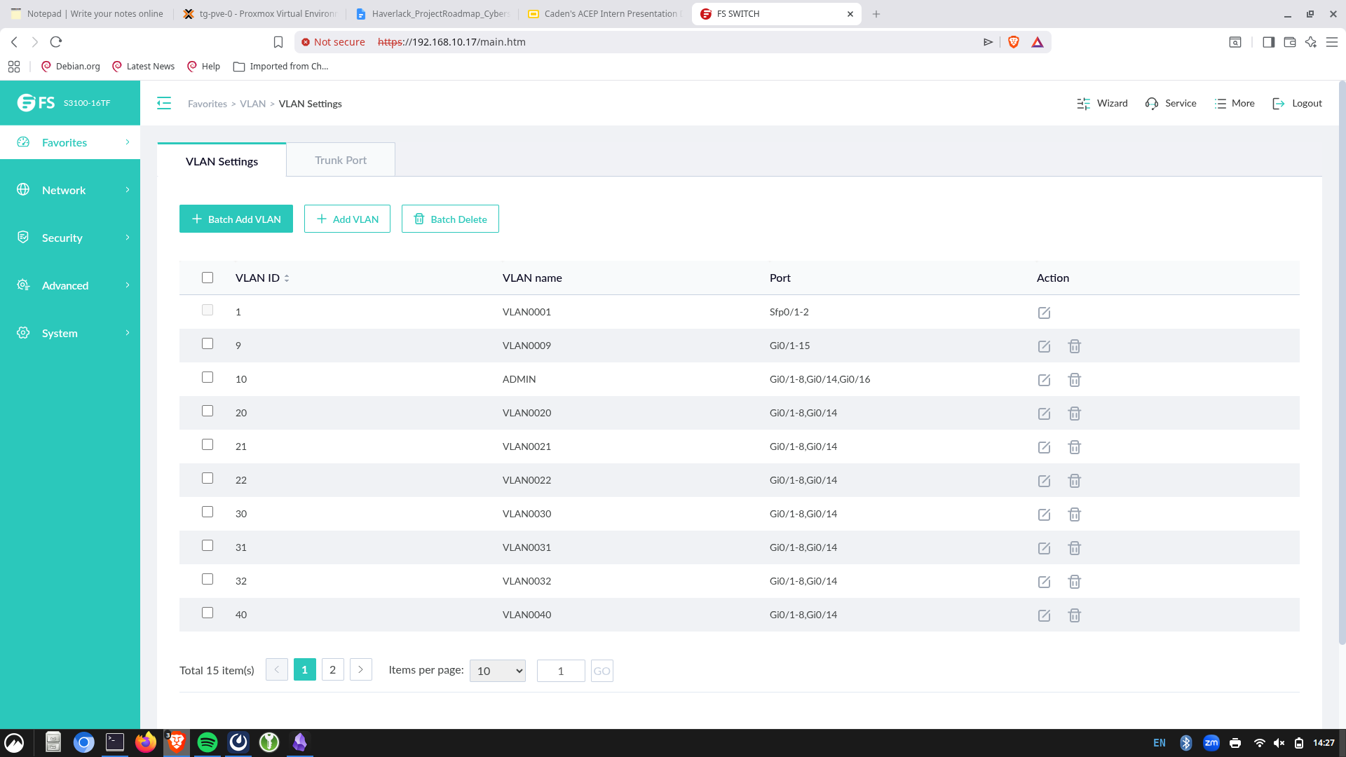
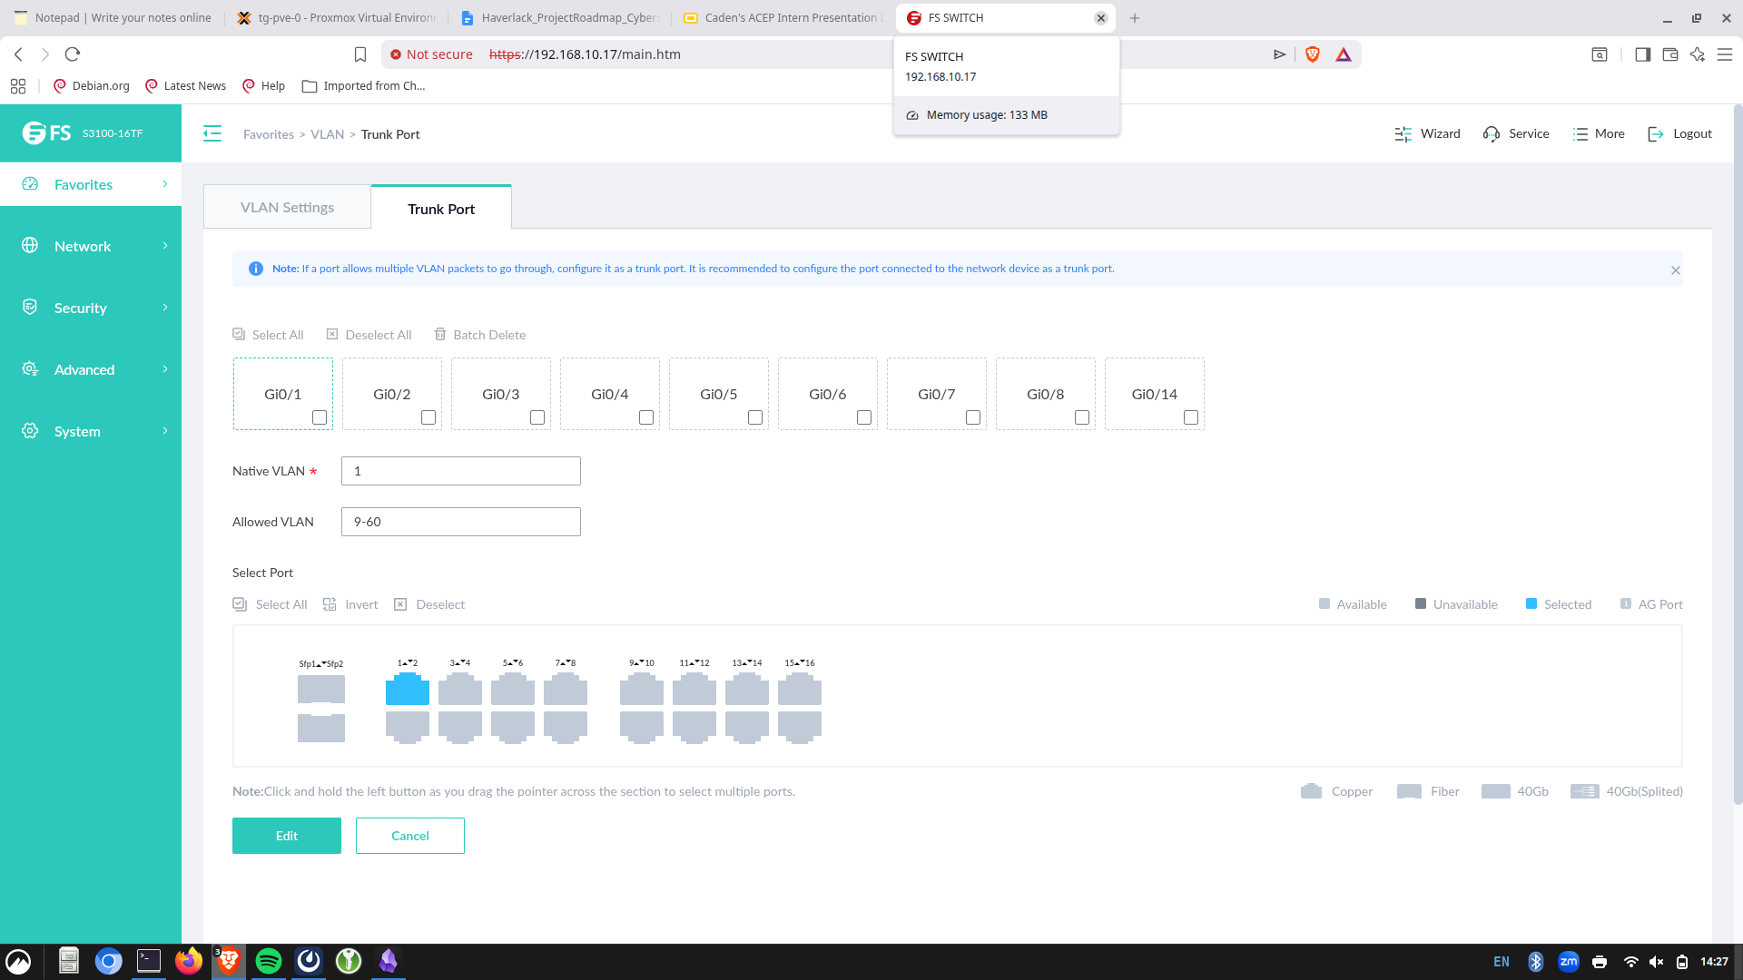
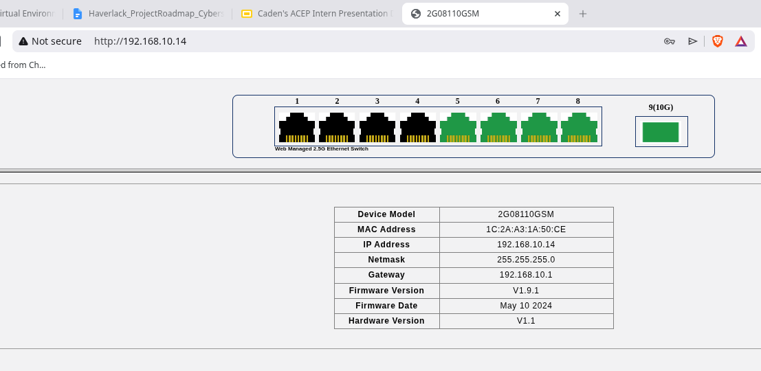
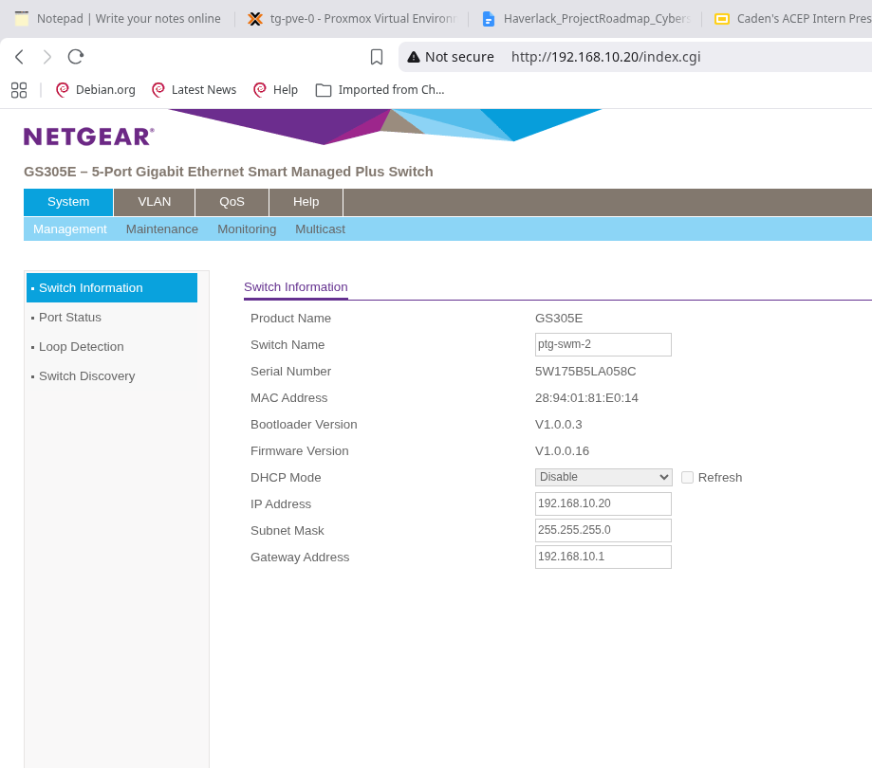
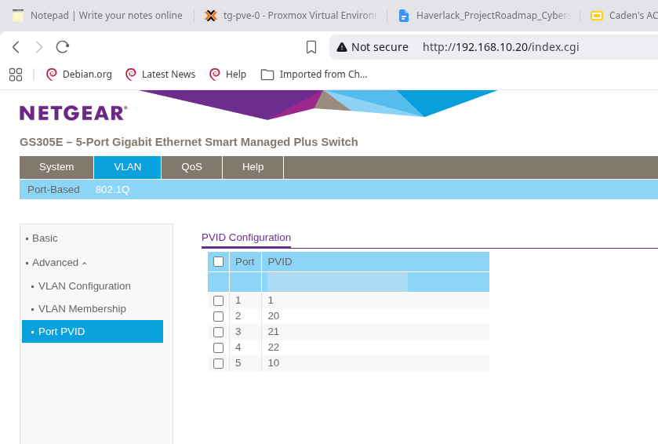
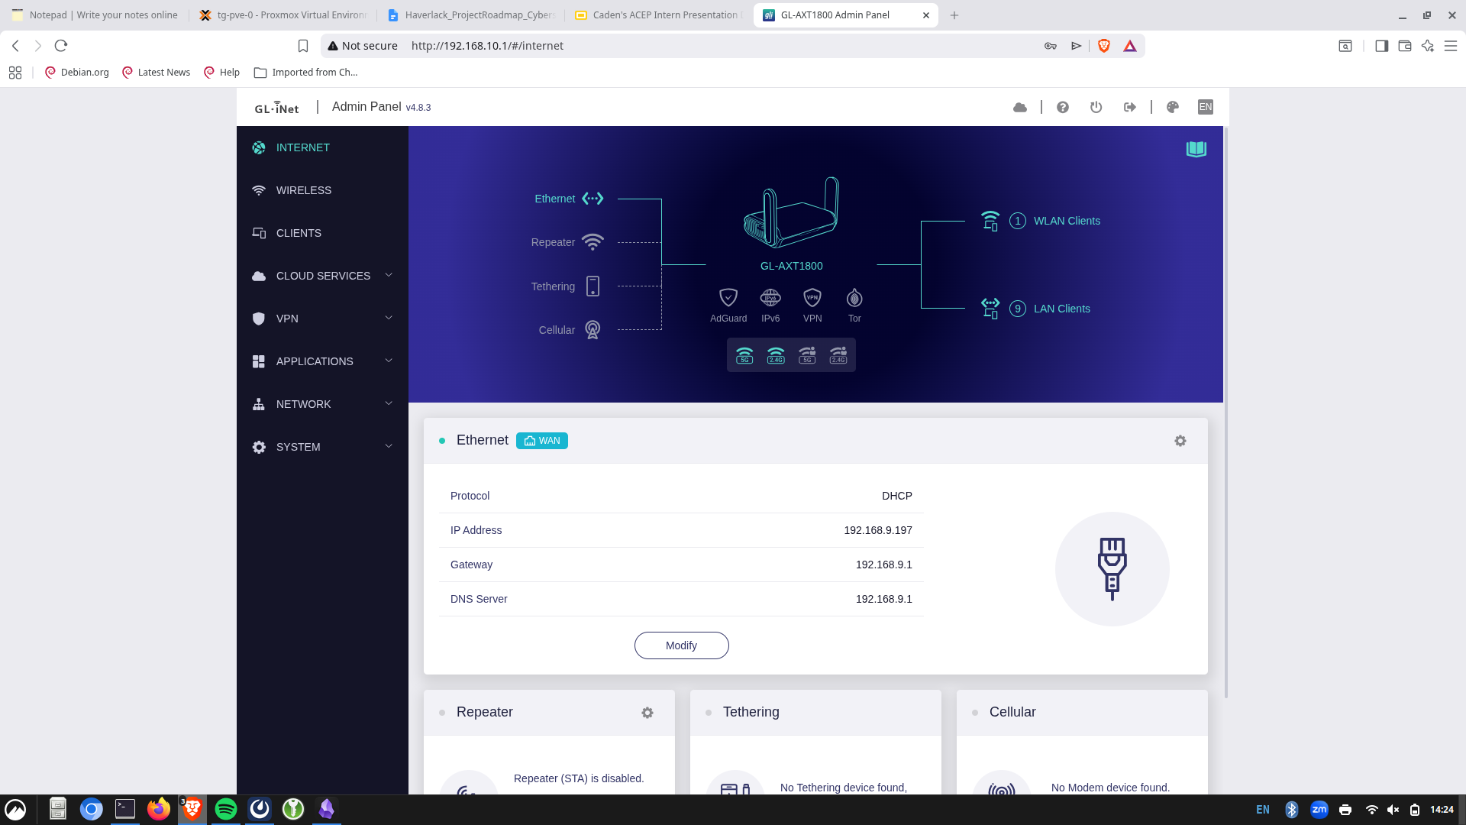
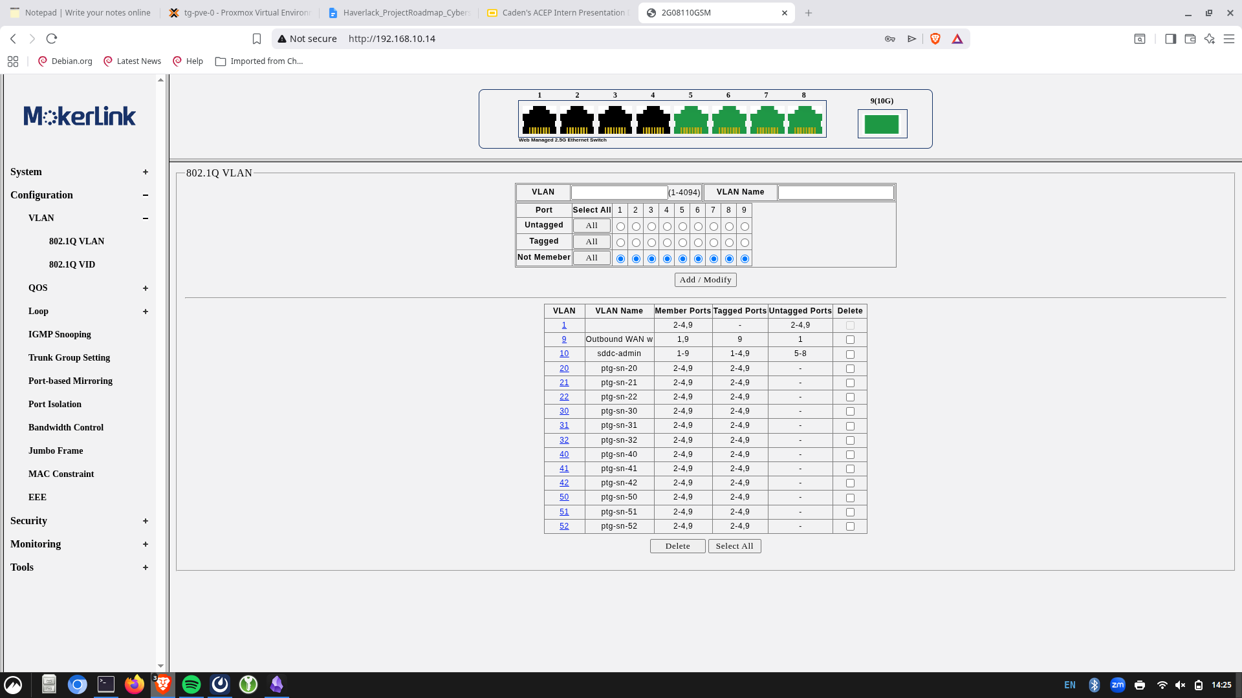
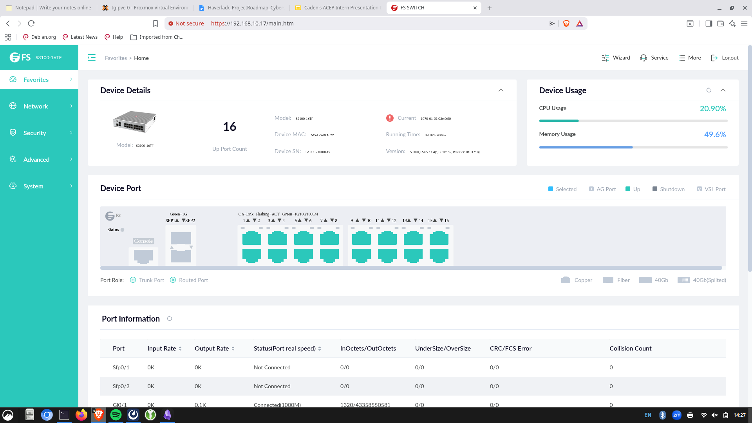
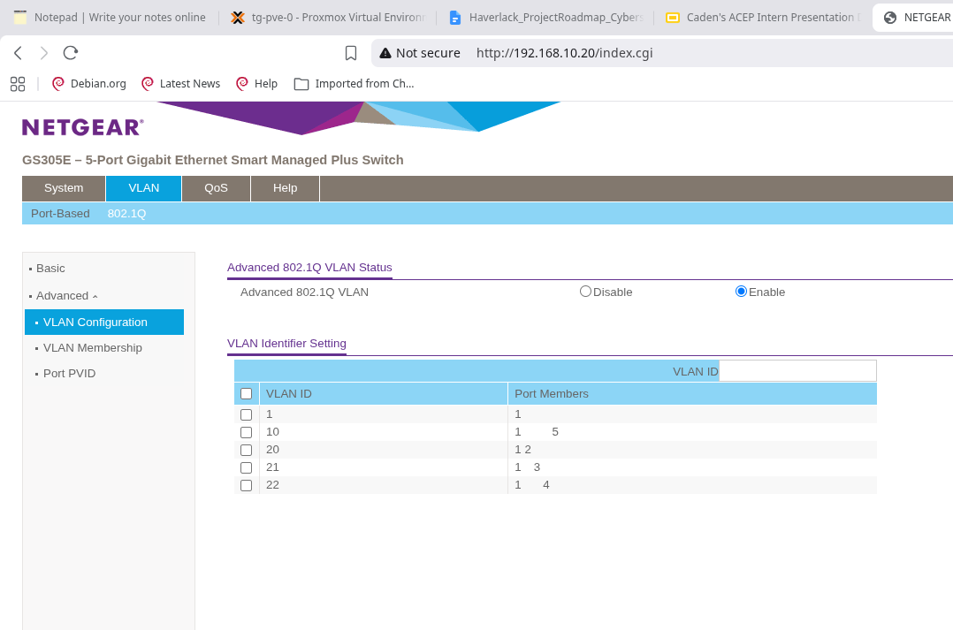
Caden Kelly ● Alaska Center for Energy and Power
Notes:
Basically click for each interface to appear.
netgear gave me a lot of practice with tagged/untagged ports, and learning to change my ip to log into a switch both before and after i change the switch’s ip
Mention how they got harder as time went on, and while it was different for each one, overall the same general ideas being the same made it easier with practice. And well you get the point… there was a lot of on the spot learning Because they were so confusing, I would often lock myself out, probably 2 times per switch configuration, and have to spend a while figuring out what I messed up so that my network stopped working. One time it took ~3 days
I genuinely gained understanding instead of memorizing what each interface did, since they were different

Slide 25
Lessons Learned
Advice for picking up where I left off
Understanding, not memorization
Diagrams!!!
Backups, snapshots, documentation
Caden Kelly ● Alaska Center for Energy and Power
‹#›
Notes:
opnsense/switch interfaces, etc. etc.

Slide 26
Lessons Learned
Advice for picking up where I left off
Understanding, not memorization
Diagrams!!!
Backups, snapshots, documentation
Caden Kelly ● Alaska Center for Energy and Power
‹#›

Slide 27
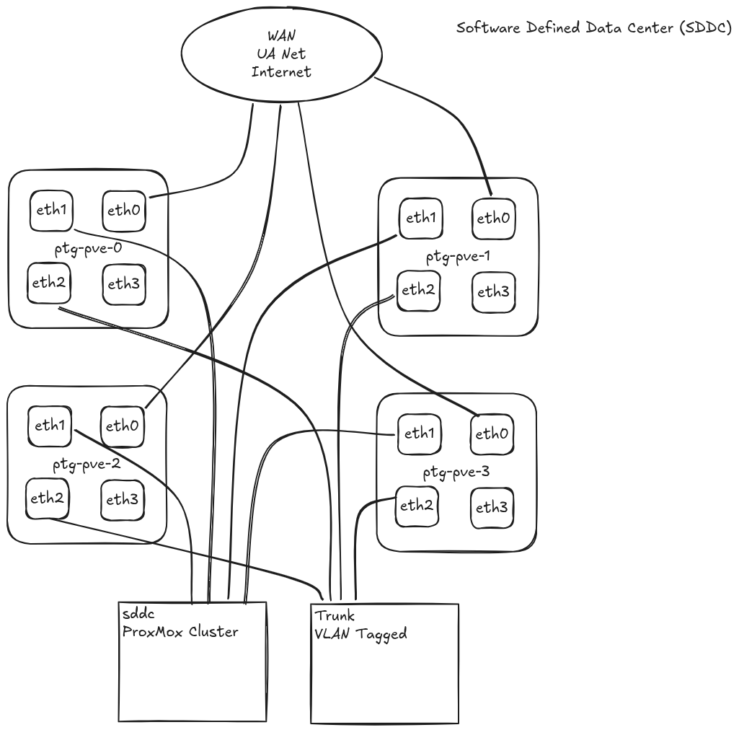
Caden Kelly ● Alaska Center for Energy and Power
‹#›

Slide 28
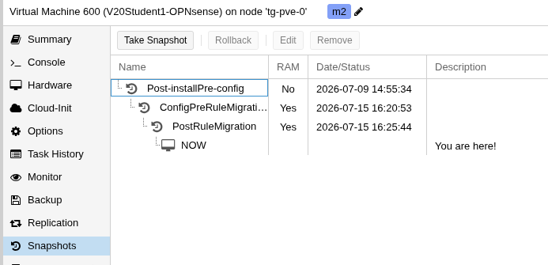
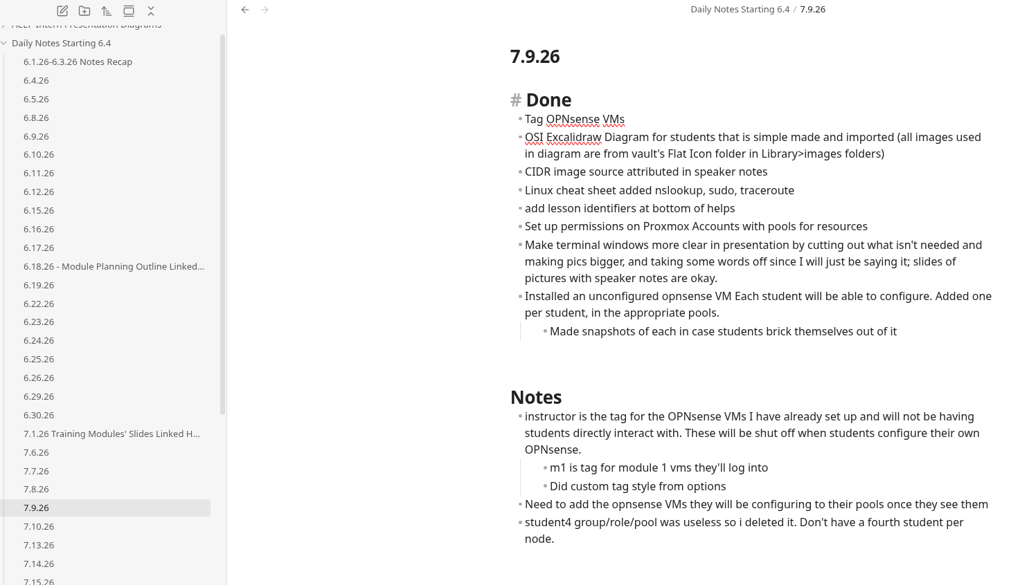
Lessons Learned
Advice for picking up where I left off
Understanding, not memorization
Diagrams!!!
Backups, documentation
Caden Kelly ● Alaska Center for Energy and Power
‹#›

Slide 29
Limitations
Amazing mentor gone for 2 weeks straight, + Dr. Checkups
Velocity vs. struggle-learning
Hardware: unideal configurations
Few testers
Caden Kelly ● Alaska Center for Energy and Power
‹#›

Slide 30
Implications
Training effective on tested groups
Can scale to rural Alaskan communities
Cost-effective setup
People can practice/ configure on their own
Caden Kelly ● Alaska Center for Energy and Power
‹#›

Slide 31
Future Directions
Modules 3, 4…
The training ground I built
Additional security practices
Etc.
Portability + Scalability
Further testing, deployment to communities, impact data collection
Different hardware configurations
Cabling, reduction of devices, etc.
Caden Kelly ● Alaska Center for Energy and Power
‹#›

Slide 32
Conclusion
Successful trainings as proving ground
I learned so much
Future directions:
Additional modules, testing, deployment
Enjoy least:
Debugging simple mistakes
Enjoy most:
Learning new topics, real skillset, bettering people's’ lives
Caden Kelly ● Alaska Center for Energy and Power
‹#›

Slide 33
Contact
Q&A
caden_kelly@berkeley.edu linkedin.com/in/caden-kelly-91574937b
Caden Kelly ● Alaska Center for Energy and Power
‹#›

